Slide 1

Modern C++元编程应用
祁 宇
qicosmos@163.com
purecpp.org

Slide 2
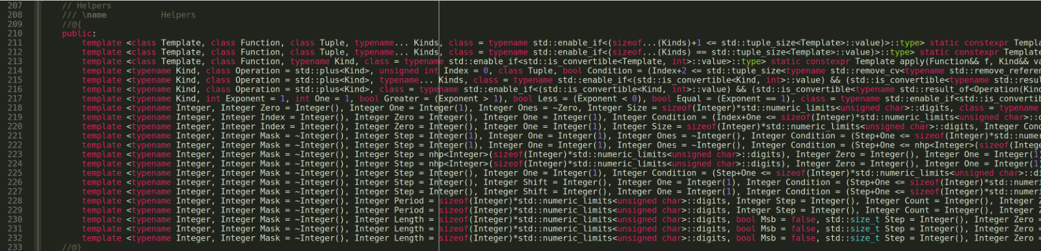
模版元
Notes:
From:https://github.com/CppCon/CppCon2018/blob/master/Presentations/from_metaprogramming_tricks_to_elegance/from_metaprogramming_tricks_to_elegance__vincent_reverdy__cppcon_2018.pdf

Slide 3
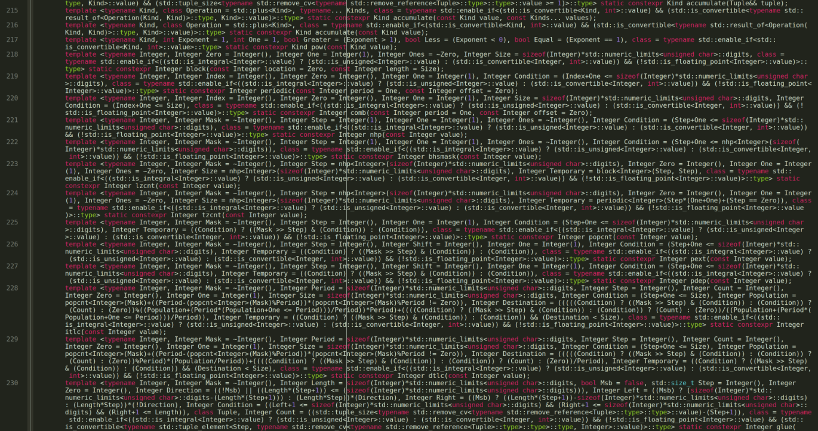

Slide 4
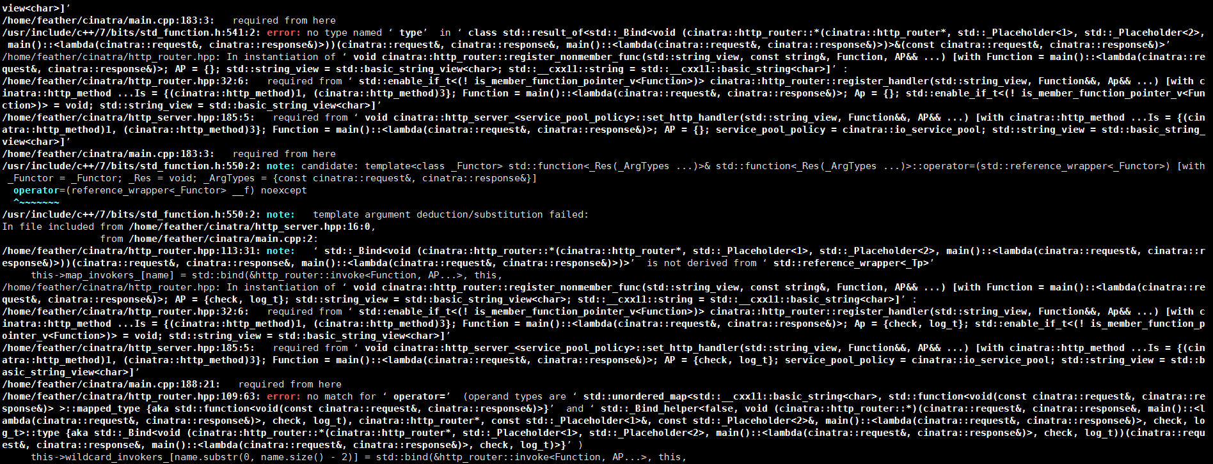
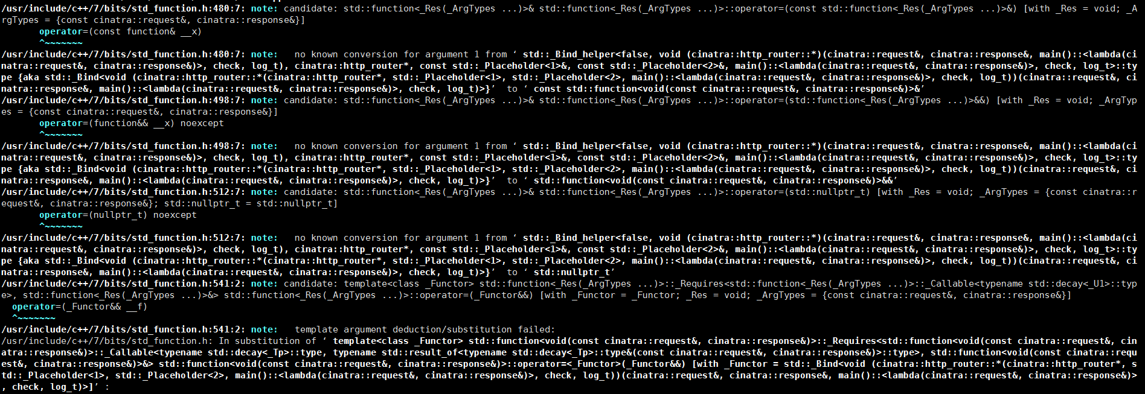

Slide 5

!! 模版元 代码墙!!
在中国C++大会上??

Slide 6
元编程的缺点
代码晦涩
比较难写
编译时间长
糟糕的错误提示

Slide 7
元编程的优点
zero-overhead 编译期计算
简洁而优雅地解决问题
终极抽象
Dream code!

Slide 8


Slide 9
Meta Programming编程思想
In C++03
元函数
SFINAE
模版递归
递归继承
Tag Dispatch

Slide 10
Meta Programming编程思想
In C++98
template<class T>
struct add_pointer { typedef T* type; };
typedef typename add_pointer<int>::type int_pointer;
元函数：编译期函数调用的类或模版类– add_pointer
调用元函数：访问元函数的内部类型::type
Type T作为元函数的value，类型是元编程中的一等公民

Slide 11
Meta Programming编程思想
In C++98
template<bool B, class T = void>
struct enable_if {};
template<class T>
struct enable_if<true, T> { typedef T type; };
template <class T>
typename enable_if<sizeof(T)==4, void>::type
foo(T t) {}
foo(1); //ok
foo('a'); //compile error
SFINAE：替换失败不是一个错误，基于模版实例化的tag dispatch

Slide 12
Meta Programming编程思想
In C++98
template <int n> struct fact98 {
static const int value = n * fact98<n - 1>::value;
};
template <> struct fact98<0> {
static const int value = 1;
};
std::cout << fact98<5>::value << std::endl;
模版递归

Slide 13
Meta Programming编程思想
In C++98
模版元编程集大成者：boost.mpl, boost.fusion
boost.mpl：编译期类型容器和算法
boost.fusion：通过异构的编译期容器融合编译期和运行期计算
struct print{
template <typename T>
void operator()(T const& x) const{
std::cout << typeid(x).name() << std::endl;
}
};
template <typename Sequence>
void print_names(Sequence const& seq){
for_each(filter_if<boost::is_class<_> >(seq), print());
}
boost::fusion::vector<int, char, std::string> stuff(2018, 'i', "purecpp");
print_names(stuff);

Slide 14
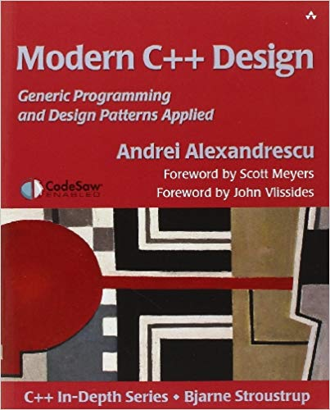

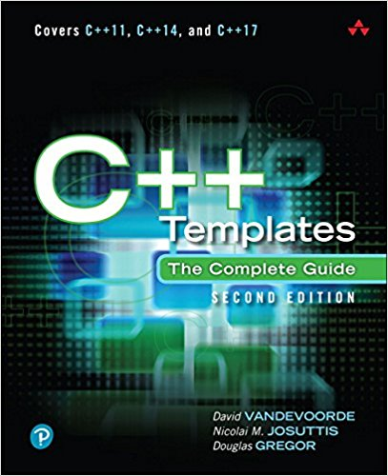
Meta Programming编程思想
In C++03
Andrei Alexandrescu

Slide 15
Meta Programming编程思想
In C++98
In C++11
template<class T>
struct add_pointer { typedef T* type; };
typedef typename add_pointer<int>::type int_pointer;
template<class T> using add_pointer = T*;
using int_pointer = add_pointer<int>;
C++11 template aliases（模版别名）
元函数由类和类模版变为模版别名

Slide 16
Meta Programming编程思想
In C++11
template<typename... Values> struct meta_list {};
using list_of_ints = meta_list<char, short, int, long>;
template<class List> struct list_size;
template<template<class...> class List, class... Elements>
struct list_size<List<Elements...>>
: std::integral_constant<std::size_t, sizeof...(Elements)> {};
constexpr auto size = list_size<std::tuple<int, float, void>>::value;
constexpr auto size1 = list_size<list_of_ints>::value;
constexpr auto size2 = list_size<boost::variant<int, float>>::value;
C++11 Variadic Templates
Variadic templates作为类型容器
通过variadic templates pack访问模版参数，不通过模版递归

Slide 17
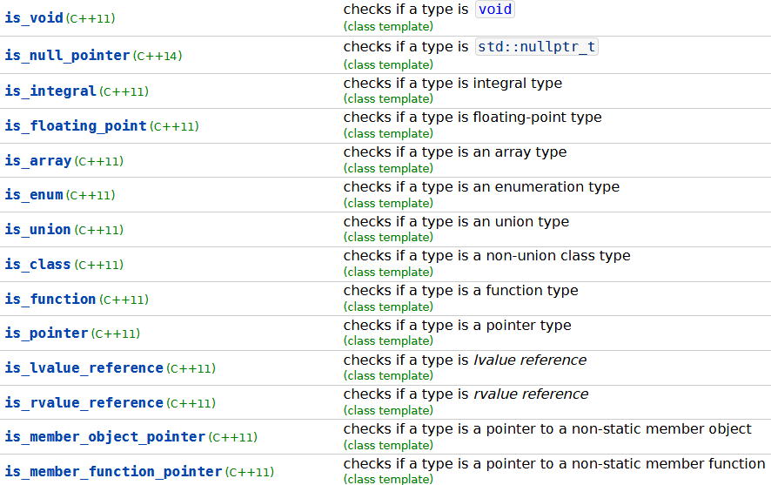
Meta Programming编程思想
C++11 type_traits提供了大量的元函数，让模版元编程变得更简单

Slide 18
Meta Programming编程思想
In C++98
In C++11
template <int n> struct fact98 {
static const int value = n * fact98<n - 1>::value;
};
template <> struct fact98<0> {
static const int value = 1;
};
std::cout << fact98<5>::value << std::endl;
constexpr int fact11(int n) {
return n <= 1 ? 1 : (n * fact11(n - 1));
}

Slide 19
Meta Programming编程思想
In C++11
In C++14
constexpr int fact11(int n) {
return n <= 1 ? 1 : (n * fact11(n - 1));
}
constexpr int fact14(int n) {
int s = 1;
for (int i = 1; i <= n; i++) { s = s * i; }
return s;
}

Slide 20

Meta Programming编程思想
In C++14
Everything changed in meta programming
新特性产生新的编程思想！
constexpr, generic lambda, variable template
Boost.hana
Louis Dionne

Slide 21
Meta Programming编程思想
Boost.hana
template <typename T>
struct type_wrapper {
using type = T;
};
template <typename T>
type_wrapper<T> type{};
//type to value
auto the_int_type = type<int>;
//value to type
using the_real_int_type = decltype(the_int_type)::type;

Slide 22
Meta Programming编程思想
Boost.hana
template <typename T>
type_wrapper<T> type{};
constexpr auto add_pointer = [](auto t) {
using T = typename decltype(t)::type;
return type<std::add_pointer_t<T>>; //type to value
};
constexpr auto intptr = add_pointer(type<int>);
static_assert(std::is_same_v<decltype(intptr)::type, int*>); //value to type
元函数的定义不再是类了，而是lambda!
generic lambda, variable template, constexpr
functional programming

Slide 23
Meta Programming编程思想
Boost.hana
auto animal_types = hana::make_tuple(hana::type_c<Fish*>, hana::type_c<Cat&>, hana::type_c<Dog*>);
auto animal_ptrs = hana::filter(animal_types, [](auto a) {
return hana::traits::is_pointer(a);
});
static_assert(animal_ptrs == hana::make_tuple(hana::type_c<Fish*>, hana::type_c<Dog*>), "");
auto animal_types = hana::make_tuple(hana::type_c<Fish*>, hana::type_c<Cat&>, hana::type_c<Dog*>);
auto animal_ptrs = hana::filter(animal_types, [](auto a) {
return hana::traits::is_pointer(a);
});
static_assert(animal_ptrs == hana::make_tuple(hana::type_c<Fish*>, hana::type_c<Dog*>), "");
通过类型容器融合编译期和运行期计算，替代boost.mpl和boost.fusion!

Slide 24
Meta Programming编程思想
Boost.hana
元函数不再是类或类模版，而是lambda
不再基于类型，而是基于值
没有SFINAE，没有模版递归
函数式编程
代码更容易理解
元编程变得更简单
融合编译期与运行期

Slide 25

C++新标准新特性产生新的idea，让元编程变得更简单更强大
variable templates
generic lambda
constexpr
constexpr
template aliases variadic templates
SFINAE
recursive
tag dispatch
C++14
C++11
C++98
Newer is Better！

Slide 26


Slide 27

静态检查
探测
编译期计算
反射
从编译期到运行期
从运行期到编译期
消除重复(宏)
接口泛化与统一
易用和灵活

Slide 28
静态检查

Slide 29
静态检查
static_assert(sizeof(void *) == 8, "expected 64-bit platform");
template<typename T, int Row, int Column>
struct Matrix {
static_assert(Row >= 0, "Row number must be positive.");
static_assert(Row >= 0, "Column number must be positive.");
static_assert(Row + Column > 0, "Row and Column must be greater than 0.");
};
Notes:
Put comments in code

Slide 30
静态检查
Enable_if 限定输入参数
安全，尽可能早地发现bug，让编译器而不是人帮我发现bug
Notes:
Put comments in code

Slide 31
静态检查
探测

Slide 32
探测
template<typename T>
struct has_foo{
template<typename U, void(U::*)()> struct SFINAE {};
template<typename U> static char check(SFINAE<U, &U::foo>*);
template<typename U> static int check(...);
static const bool value = sizeof(check<T>(0)) == sizeof(char);
};
SFINAE In C++98
Notes:
Put comments in code

Slide 33
探测
template< class, class = void >
struct has_foo : std::false_type {};
template< class T >
struct has_foo< T, std::void_t<decltype(std::declval<T>().foo())> > :
std::true_type {};
template< class, class = void >
struct has_member : std::false_type {};
template< class T >
struct has_member< T, std::void_t<decltype(std::declval<T>().member)> > :
std::true_type {};
SFINAE In C++17, decltype, void_t
Notes:
Put comments in code

Slide 34
探测
AOP(Aspect Oriented Programming)
#define HAS_MEMBER(member)\
template<typename T, typename... Args>\
struct has_##member\
{\
private:\
template<typename U> static auto Check(int) -> decltype(std::declval<U>().member(std::declval<Args>()...), std::true_type()); \
template<typename U> static std::false_type Check(...);\
public:\
enum{value = std::is_same<decltype(Check<T>(0)), std::true_type>::value};\
};
HAS_MEMBER(before)
HAS_MEMBER(after)

Slide 35
探测
struct check_login_input {
bool before(request& req, response& res) {
//...
if (!check_input(res, user_name, password)) {
return false;
}
//...
return true;
}
};
server.set_http_handler<GET, POST>("/login", &purecpp_controller::login, &purecpp_ctl, check_login_input{});
constexpr bool has_befor_mtd = has_before<decltype(item), request&, response&>::value;
if constexpr (has_befor_mtd)
r = item.before(req, res);
AOP in feather : https://github.com/qicosmos/feather

Slide 36
静态检查
探测
编译期计算

Slide 37
Introduction
Use a cache!
JavaMethod getMethod(const std::string& methodName)
{
static std::unordered_map<std::string, JavaMethod> cache;
return cache.try_emplace(methodName, methodName).first->second;
}
try_emplace needs to calculate the hash of methodName
Collisions expected as thousands of methods in cache
Can we do better?

Slide 38
Introduction
Use a cache!
class InputStream // java.io.InputStream
{
public:
void close() { jclass.getMethod("close").invoke(); }
long skip(long bytes) { return jclass.getMethod("skip").invoke(bytes); }
int read() { return jclass.getMethod("read").invoke(); }
};
String literals
methodName is known at compile-time
it should be possible to calculate the cache slot at compile-time
Fallback to run-time hash if methodName is not a string literal
Somebody must have done this already, right?
Notes:
Add life-time management to requirements

Slide 39
Introduction
Ben Deane’s and Jason Turner’s “constepxr all the things”^{1,2}
cx::map<Key, Value>
map is either completely compile-time or completely run-time
If lookup is compile-time then all values must also be known at compile-time
JavaMethod can only be resolved at run-time
✘ Compile-time lookup of run-time value not possible
¹https://www.youtube.com/watch?v=PJwd4JLYJJY
²there are many more compile-time only maps (for example boost::hana::map)

Slide 40
Introduction
Louis Dionne’s C++ meta-programming talk at meeting C++¹
event_system events{{"foo", "bar", "baz"}}
✔ Lookup at compile-time and value-storage at runtime
✔ Can fallback to run-time lookup if key is not string literal
✘ Need to know all possible keys in advance
¹https://goo.gl/M4vhqc from slide 73 onwards

Slide 41
Introduction
Let’s roll our own!
semi::map<Key, Value>
Requirements
Lookup at compile-time and value-storage at runtime
Can fallback to run-time lookup if key is not string literal
Keys need not to be known ahead of time

Slide 42
静态检查
探测

Slide 43
2. The basic principle

Slide 44
The basic principle
The basic principle is embarrassingly simple!
template <int> std::string map;
? ? ?
✔ map with int keys and std::string values
✔ Lookup at compile-time and value-storage at runtime
✔ Keys need not be known ahead of time
Compile-time lookup, run-time storage map in a single line of code
Notes:
Bahuptung auf Englisch: claim!!!

Slide 45
The basic principle
What keys can we use?
template <Key> Value map;
Any non-type template parameter types
essentially bool, integral types and nullptr_t
C++20: Class types as non-type template parameters!
Any compile-time literals, user-defined literals, ...
It’s 2018: no compiler supports class types as template parameters

Slide 46
3. Supporting more key types in 2018

Slide 47
Supporting more key types in 2018
Use typenames instead
template <typename> Value map;
We need a “function” which maps any key to a unique typename:
UniqueReturnType key2type(Key key);
std::cout << map<decltype(key2type("foo"))>;
Is it possible to write key2type in C++?

Slide 48
Supporting more key types in 2018
Implementing key2type for integral key types
template <auto...> struct dummy_t {};
template <typename Key>
constexpr auto key2type(Key key)
{
return dummy_t<key>{};
}
std::cout << map<decltype(key2type(5))>;
Returns instance of dummy_t<5> for key “5”, and so on…
✘ Compiler-error: “key” not a constant expression

Slide 49
Supporting more key types in 2018
Implementing key2type for integral key types
template <auto...> struct dummy_t {};
template <typename Lambda>¹
constexpr auto key2type(Lambda lambda)
{
return dummy_t<lambda()>{};
}
std::cout << map<decltype(key2type([] () { return 5; }))>;²
¹enable_if template parameter removed for brevity
²only shown to demonstrate usage: error due to lambda being used in an unevaluated context - will be resolved on slide 22

Slide 50
Supporting more key types in 2018
Implementing key2type for integral key types
template <auto...> struct dummy_t {};
template <typename Lambda>¹
constexpr auto key2type(Lambda lambda)
{
return dummy_t<lambda()>{};
}
#define ID(x) []() constexpr { return x; }
std::cout << map<decltype(key2type(ID(5)))> << std::endl;²
Still doesn’t work with string literals etc.
¹enable_if template parameter removed for brevity
²only shown to demonstrate usage: error due to lambda being used in an unevaluated context - will be resolved on slide 22

Slide 51
Supporting more key types in 2018
Supporting string literals:
template <typename Lambda, std::size_t... I>
constexpr auto str2type(Lambda lambda, std::index_sequence<I...>)
{
return dummy_t<lambda()[I]...>{};
}
template <typename Lambda>¹
constexpr auto key2type(Lambda lambda)
{
return array2type (lambda, std::make_index_sequence<strlen³(lambda())>{});
}
std::cout << map<decltype(key2type(ID(“foo”)))> << std::endl;²
Maps “foo” onto dummy_t<’f’,’o’,’o’>
¹enable_if template parameter removed for brevity
²only shown to demonstrate usage: error due to lambda being used in an unevaluated context - will be resolved on slide 22
³strlen is marked constexpr in gcc only: substitute implementation for other compilers is left as an exercise for the reader

Slide 52
4. Putting it all together

Slide 53
Putting it all together
template <typename> std::string map_value;
map_value<decltype(key2type(ID("conference")))> = "cppcon";
Notes:
Change name to map_value

Slide 54
Putting it all together
template <typename Value,typename>
Value& static_map_get()
{
static Value value;
return value;
}
static_map_get<std::string, decltype(key2type(ID("conference")))>() = "cppcon";

Slide 55
Putting it all together
template <typename Key, typename Value>
class static_map
{
public:
template <typename>
static Value& get()
{
static Value value;
return value;
}
};
using map = static_map<std::string, std::string>;
map::get<decltype(key2type(ID("conference")))>() = "cppcon";

Slide 56
Putting it all together
template <typename Key, typename Value>
class static_map
{
public:
template <typename Lambda>
static Value& get(Lambda lambda)
{
return get_internal<decltype(key2type(lambda))>();
}
private:
template <typename>
static Value& get_internal()
{
static Value value;
return value;
}
};
using map = static_map<std::string, std::string>;
map::get(ID("conference")) = "cppcon";¹
¹constexpr lambda is now being evaluated as a normal parameter which resolves the issue mentioned in the footnote of slides 15,16,17

Slide 57
Putting it all together
template <typename Key, typename Value>
class static_map
{
public:
template <typename Lambda>
static Value& get(Lambda lambda)
{
static_assert(std::is_convertible_v<decltype(lambda()), Key>);
return get_internal<decltype(key2type(lambda))>();
}
private:
template <typename>
static Value& get_internal()
{
static Value value;
return value;
}
};
using map = static_map<std::string, std::string>;
map::get(ID("conference")) = "cppcon";¹
¹constexpr lambda is now being evaluated as a normal parameter which resolves the issue mentioned in the footnote of slides 15,16,17

Slide 58
Putting it all together
What’s the performance?
int& getAge()
{
using map =
semi::static_map<std::string, int>;
return map::get(ID("age"));
}
mov eax, OFFSET FLAT:dummy_tIvalue
ret
Compiler Explorer: https://gcc.godbolt.org/z/6CRZ9W
Just as fast as accessing a global variable

Slide 59
5. Optional run-time lookup

Slide 60
Optional run-time lookup
Impossible to write run-time version of key2type...
UniqueReturnType key2type(Key key);
...also impossible to somehow call get with run-time key
template <typename Lambda> get(Lambda lambda);
We can write a big switch-like statement:
if (key == “food”) return get(ID(“food”));
else if (key == “drink”) return get(ID(“drink”));
...
...but then all keys need to be known in advance.

Slide 61
Optional run-time lookup
Solution: maintain run-time map of pointers to static locals
std::unordered_map<Key, Value*> runtime_map;
Add to map when value is accessed via compile-time literal:
template <typename>
static Value& get_internal (const Key& key)
{
static Value value;
runtime_map[key] = &value;
return value;
}
Slow: Executed every time get is called
Only add to map when get_internal is executed for the first time?

Slide 62
Optional run-time lookup
Closer look at the static local variable:
template <typename>
static Value& get_internal()
{
static Value value;
return value;
}

Slide 63
Optional run-time lookup
Closer look at the static local variable:
template <typename>
static Value& get_internal()
{
static Value value;
return value;
}
Creates storage
Calls constructor

Slide 64
Optional run-time lookup
Closer look at the static local variable:
struct ConstructorInvoker
{
ConstructorInvoker(char* mem) { new (mem) Value; }
};
template <typename>
static Value& get_internal()
{
alignas (Value) static char storage[sizeof(Value)];
static ConstructorInvoker invoker(storage);
return *reinterpret_cast<Value*> (storage);
}
This change has no effect on the generated assembly

Slide 65
Optional run-time lookup
!! Undefined Behaviour!!
Undefined behaviour?!?
struct ConstructorInvoker
{
ConstructorInvoker(char* mem) { new (mem) Value; }
};
template <typename>
static Value& get_internal()
{
alignas (Value) static char storage[sizeof(Value)];
static ConstructorInvoker invoker(storage);
return *reinterpret_cast<Value*> (storage);
}
At cppcon??
No alignment issues
No aliasing
No excuses: standard says reinterpret_cast to Value is UB!

Slide 66
Optional run-time lookup
Undefined behaviour?!?
struct ConstructorInvoker
{
ConstructorInvoker(char* mem) { new (mem) Value; }
};
template <typename>
static Value& get_internal()
{
alignas (Value) static char storage[sizeof(Value)];
static ConstructorInvoker invoker(storage);
return *std::launder(reinterpret_cast<Value*> (storage));
}
Meet the most obscure C++ function: std::launder
Can be used to avoid UB in these types of cases
cppreference.com shows exactly this example
Notes:
Mention that std::launder hints to the compiler...

Slide 67
Optional run-time lookup
Controlling the construction with an init flag
struct ConstructorInvoker
{
ConstructorInvoker(char* mem) { new (mem) Value; }
};
template <typename>
static Value& get_internal(const Key& key)
{
alignas (Value) static char storage[sizeof(Value)];
static ConstructorInvoker invoker(storage);
return *reinterpret_cast<Value*> (storage);
}

Slide 68
Optional run-time lookup
Controlling the construction with a needs_init flag
void initialise(const Key& key, char* mem, bool& needs_init);
template <typename>
static Value& get_internal(const Key& key)
{
alignas (Value) static char storage[sizeof(Value)];
static bool needs_init = true;
if (needs_init) {
initialise(key, storage, needs_init); needs_init = false;
}
return *reinterpret_cast<Value*> (storage);
}
No more thread-safety
Generated code is faster: no more locks
Just like STL containers, we do not claim that semi::map is thread-safe
Notes:
You need a lock

Slide 69
Optional run-time lookup
Controlling the construction with a needs_init flag
void initialise(const Key& key, char* mem, bool& needs_init);
template <typename>
static Value& get_internal(const Key& key)
{
alignas (Value) static char storage[sizeof(Value)];
static bool needs_init = true;
if (__builtin_expect(needs_init, false)) {
initialise(key, storage, needs_init); needs_init = false;
}
return *reinterpret_cast<Value*> (storage);
}
No more thread-safety
Generated code is faster: no more locks
Just like STL containers, we do not claim that semi::map is thread-safe
Notes:
You need a lock

Slide 70
Optional run-time lookup
Closer look at the initialise function
void initialise(const Key& key, char* mem, bool& needs_init)
{
new (mem) Value ;
}

Slide 71
Optional run-time lookup
Closer look at the initialise function
void initialise(const Key& key, char* mem, bool& needs_init)
{
runtime_map.try_emplace(key, new (mem) Value );
}
static std::unorederd_map<Key, std::unique_ptr<Value >> runtime_map;
Add Value to runtime_map

Slide 72
Optional run-time lookup
Closer look at the initialise function
void initialise(const Key& key, char* mem, bool& needs_init)
{
runtime_map.try_emplace(new (mem) Value, ValueDeleter{needs_init});
}
struct ValueDeleter
{
void operator()(Value* v) { v->~Value(); }
bool& needs_init;
};
static std::unorederd_map<Key, std::unique_ptr<Value, ValueDeleter>> runtime_map;
Add Value to runtime_map
Ensure that destructor is called but that storage is not deallocated

Slide 73
Optional run-time lookup
Closer look at the initialise function
void initialise(const Key& key, char* mem, bool& needs_init)
{
runtime_map.try_emplace(new (mem) Value, ValueDeleter{needs_init});
}
struct ValueDeleter
{
void operator()(Value* v) { v->~Value(); needs_init = true; }
bool& needs_init;
};
static std::unorederd_map<Key, std::unique_ptr<Value, ValueDeleter>> runtime_map;
Add Value to runtime_map
Ensure that destructor is called but that storage is not deallocated

Slide 74
Optional run-time lookup
Getting a value from a runtime key is now trivial!
static Value& get(const Key& key)
{
return *runtime_map[key];
}
using map = semi::static_map<std::string, std::string>
std::string key;
std::cin >> key;
map::get(key);
We also need to account for the case where a value is accessed via run-time key first and then via a compile-time key literal
Not very interesting: see full-code for details on how this is done

Slide 75
Optional run-time lookup
Additional benefit: we can now also remove values from our map at run-time
static void clear()
{
runtime_map.clear();
}
template <typename Lambda>
static void erase(Lambda lambda)
{
runtime_map.erase(lambda());
}
static std::unordered_map<Key, std::unique_ptr<Value, ValueDeleter>> runtime_map;
Removes both from runtime_map and compile-time map

Slide 76
Optional run-time lookup
And what about performance?
int& getAge()
{
using map =
semi::static_map<std::string, int>;
return map::get(ID("age"));
}
cmpb $0, map::needs_init
jne initialise
movl map::storage, %eax
ret
.initialise:
.
Lots of code
.
Only executed the first time value is accessed
Compiler Explorer: https://gcc.godbolt.org/z/g7Rb4Z

Slide 77
6. But everything is static?

Slide 78
But everything is static?
template <typename Key, typename Value>
class static_map
{
public:
static_map() = delete;
template <typename Lambda>
static Value& get(Lambda lambda);
template <typename Lambda>
static void erase(Lamnda lambda);
static void clear();
...
};
Storage needs to be static!
So all methods declared static as well
No per-instance storage

Slide 79
But everything is static?
Do you really need a non-static map?
Caches are often used in singletons anyway
JavaMethod getMethod(const std::string& methodName)
{
using cache = semi::static_map<std::string, JavaMethod > cache;
return cache::get(methodName);
}
Collision if semi-map with same Key/Value types exists anywhere else in the code
Life-time can still be managed with clear method

Slide 80
But everything is static?
Do you really need a non-static map?
Caches are often used in singletons anyway
JavaMethod getMethod(const std::string& methodName)
{
struct Tag {};
using cache = semi::static_map<std::string, JavaMethod, Tag> cache;
return cache::get(methodName);
}
Life-time can still be managed with clear method
But I still really need a non-static map - is this possible?

Slide 81
But everything is static?
Normal runtime-maps: each this pointer points to a map of keys
“height”, 67
Instance A
(this = 0x7f000100)
std::map<std::string, int>
“width”, 110
“depth”, 80
height and depth appear in two different instances
“age”, 43
Instance B
(this = 0x7f000200)
std::map<std::string, int>
“height”, 178
Instance C
(this = 0x7f000300)
std::map<std::string, int>
“depth”, 32
Instances
Key/Value pairs

Slide 82
But everything is static?
Invert the map: each key points to a map of this pointers!
Does not depend on this!
Instance A (this = 0x7f000100), 67
“height”
std::map<void*, int>
Instance B (this = 0x7f000200), 178
Instance A (this = 0x7f000100), 80
“depth”
std::map<void*, int>
Instance C (this = 0x7f000300), 32
“width”
std::map<void*, int>
Instance A (this = 0x7f000100), 110
“age”
std::map<void*, int>
Instance B (this = 0x7f000200), 43
Instances
Key/Value pairs

Slide 83
But everything is static?
Solution: each key points to a map of this pointers!
using map = semi::static_map<Key, Value>;

Slide 84
But everything is static?
Solution: each key points to a map of this pointers!
using map = semi::static_map<Key, std::map<void*, Value>>;

Slide 85
But everything is static?
Solution: each key points to a map of this pointers!
namespace semi
{
template <typename Key, typename Value>
class map
{
public:
template <typename Lambda>
Value& get(Lambda lambda)
{
return instance_map::get(lambda)[this];
}
private:
using instance_map = semi::static_map<Key, flat_map<void*, Value>>;
};
} // namespace semi
semi::map<std::string, std::string> m;
m.get(ID("conference")) = "cppcon";
Not static

Slide 86
But everything is static?
Invert the map: each key points to a map of this pointers!
namespace semi
{
template <typename Key, typename Value>
class map
{
public:
template <typename Lambda>
Value& get(Lambda lambda)
{
return instance_map::get(lambda)[this];
}
private:
using instance_map = semi::static_map<Key, std::map<void*, Value>>;
};
} // namespace semi
semi::map<std::string, std::string> m;
m.get(ID("conference")) = "cppcon";
Uses static_map

Slide 87
But everything is static?
Invert the map: each key points to a map of this pointers!
namespace semi
{
template <typename Key, typename Value>
class map
{
public:
template <typename Lambda>
Value& get(Lambda lambda)
{
return instance_map::get(lambda)[this];
}
private:
using instance_map = semi::static_map<Key, std::map<void*, Value>>;
};
} // namespace semi
semi::map<std::string, std::string> m;
m.get(ID("conference")) = "cppcon";
Use this parameter as the key

Slide 88
But everything is static?
But wait, doesn’t that defeat the object?
Calculating the hash of a memory address is often computationally more efficient compared to hashing other key types
But wait, doesn’t that defeat the object?
Calculating the hash of a memory address is often computationally more efficient compared to hashing other key types
You normally have a large number of keys compared to the number of instances (especially true for caches)
using map = semi::static_map<Key, std::map<void*, Value>¹>;
Often only has 1-3 entries
¹even better performance is achieved by using a flat map container type here which is used in the final benchmarked code
Notes:
Re-write this slide to show pros and cons

Slide 89
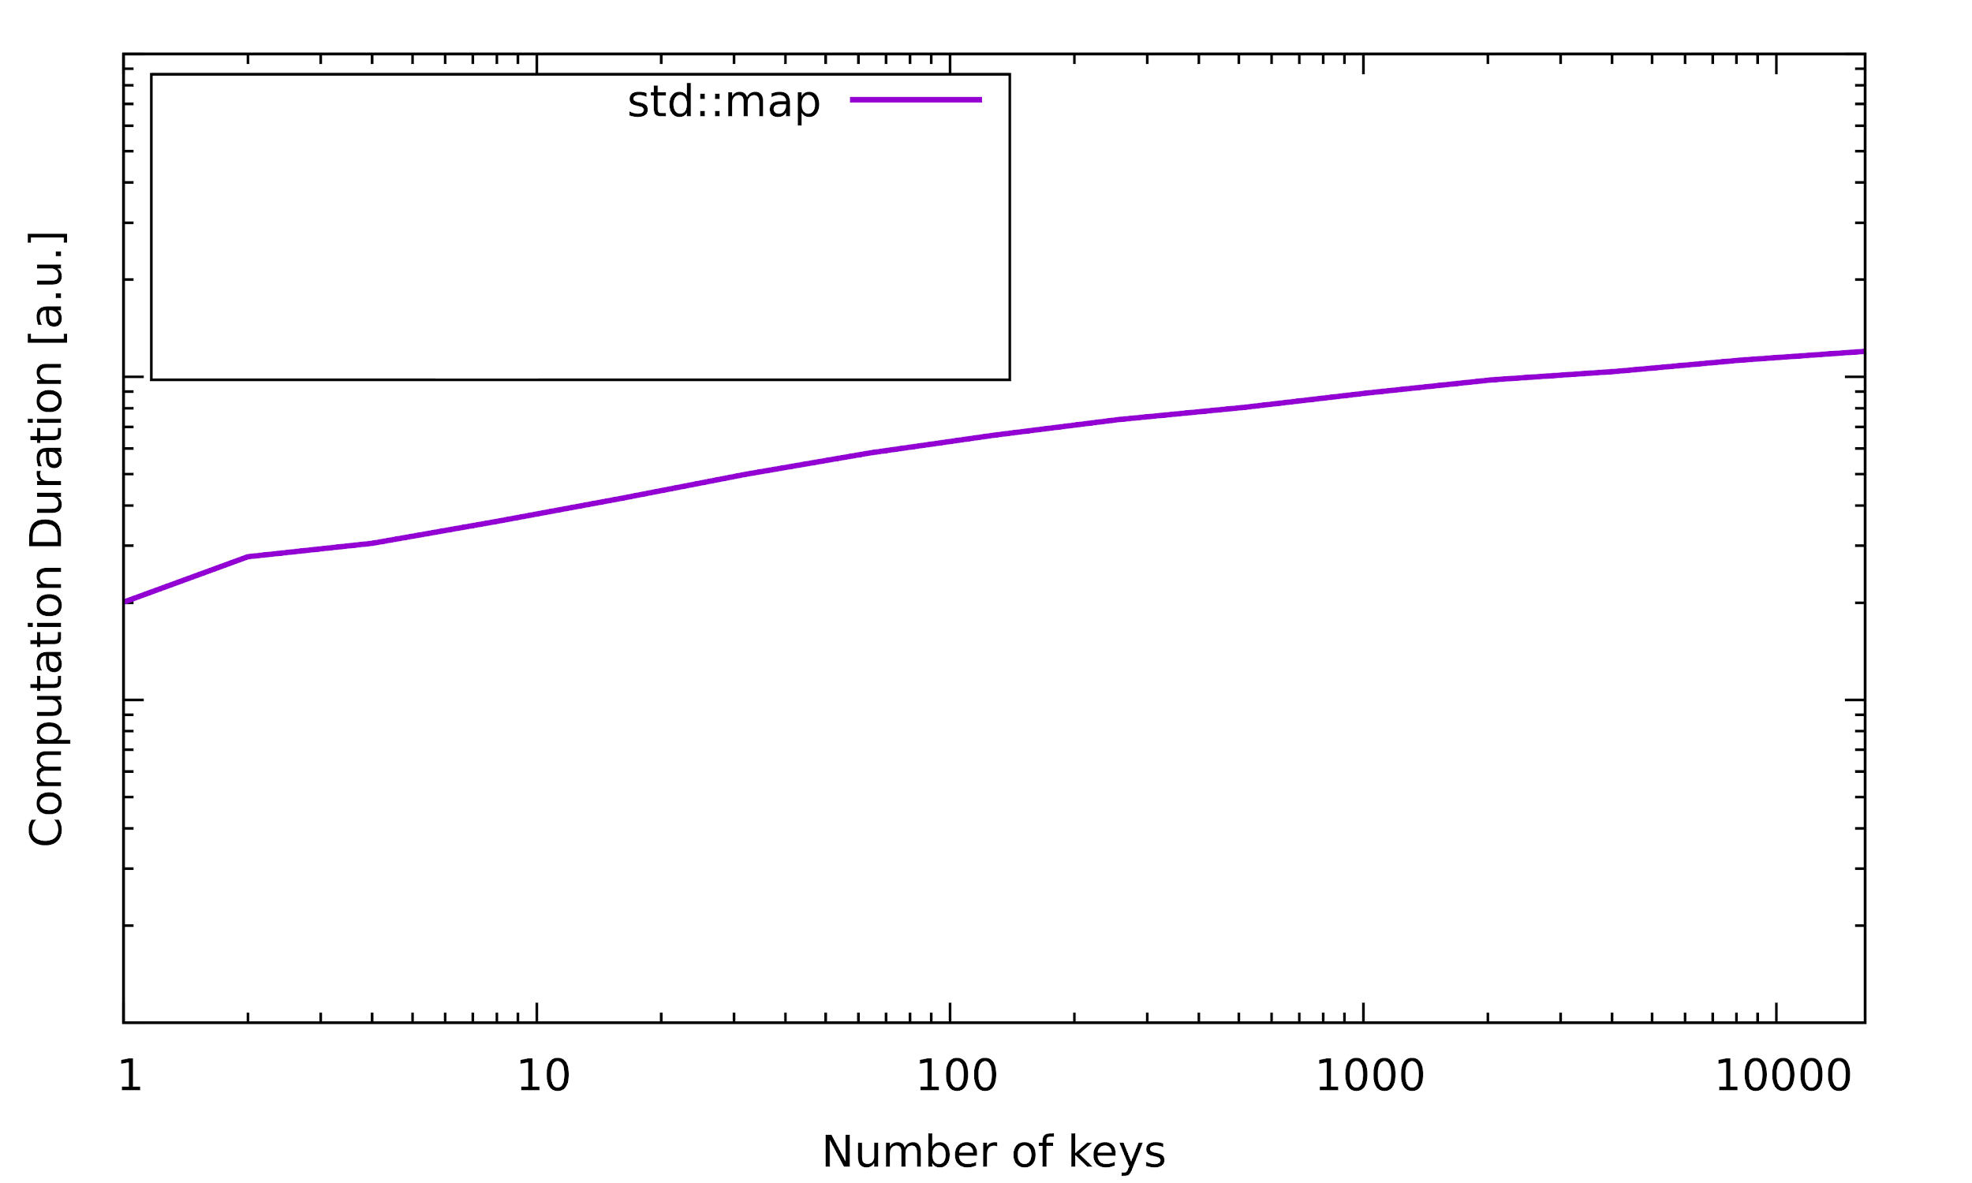
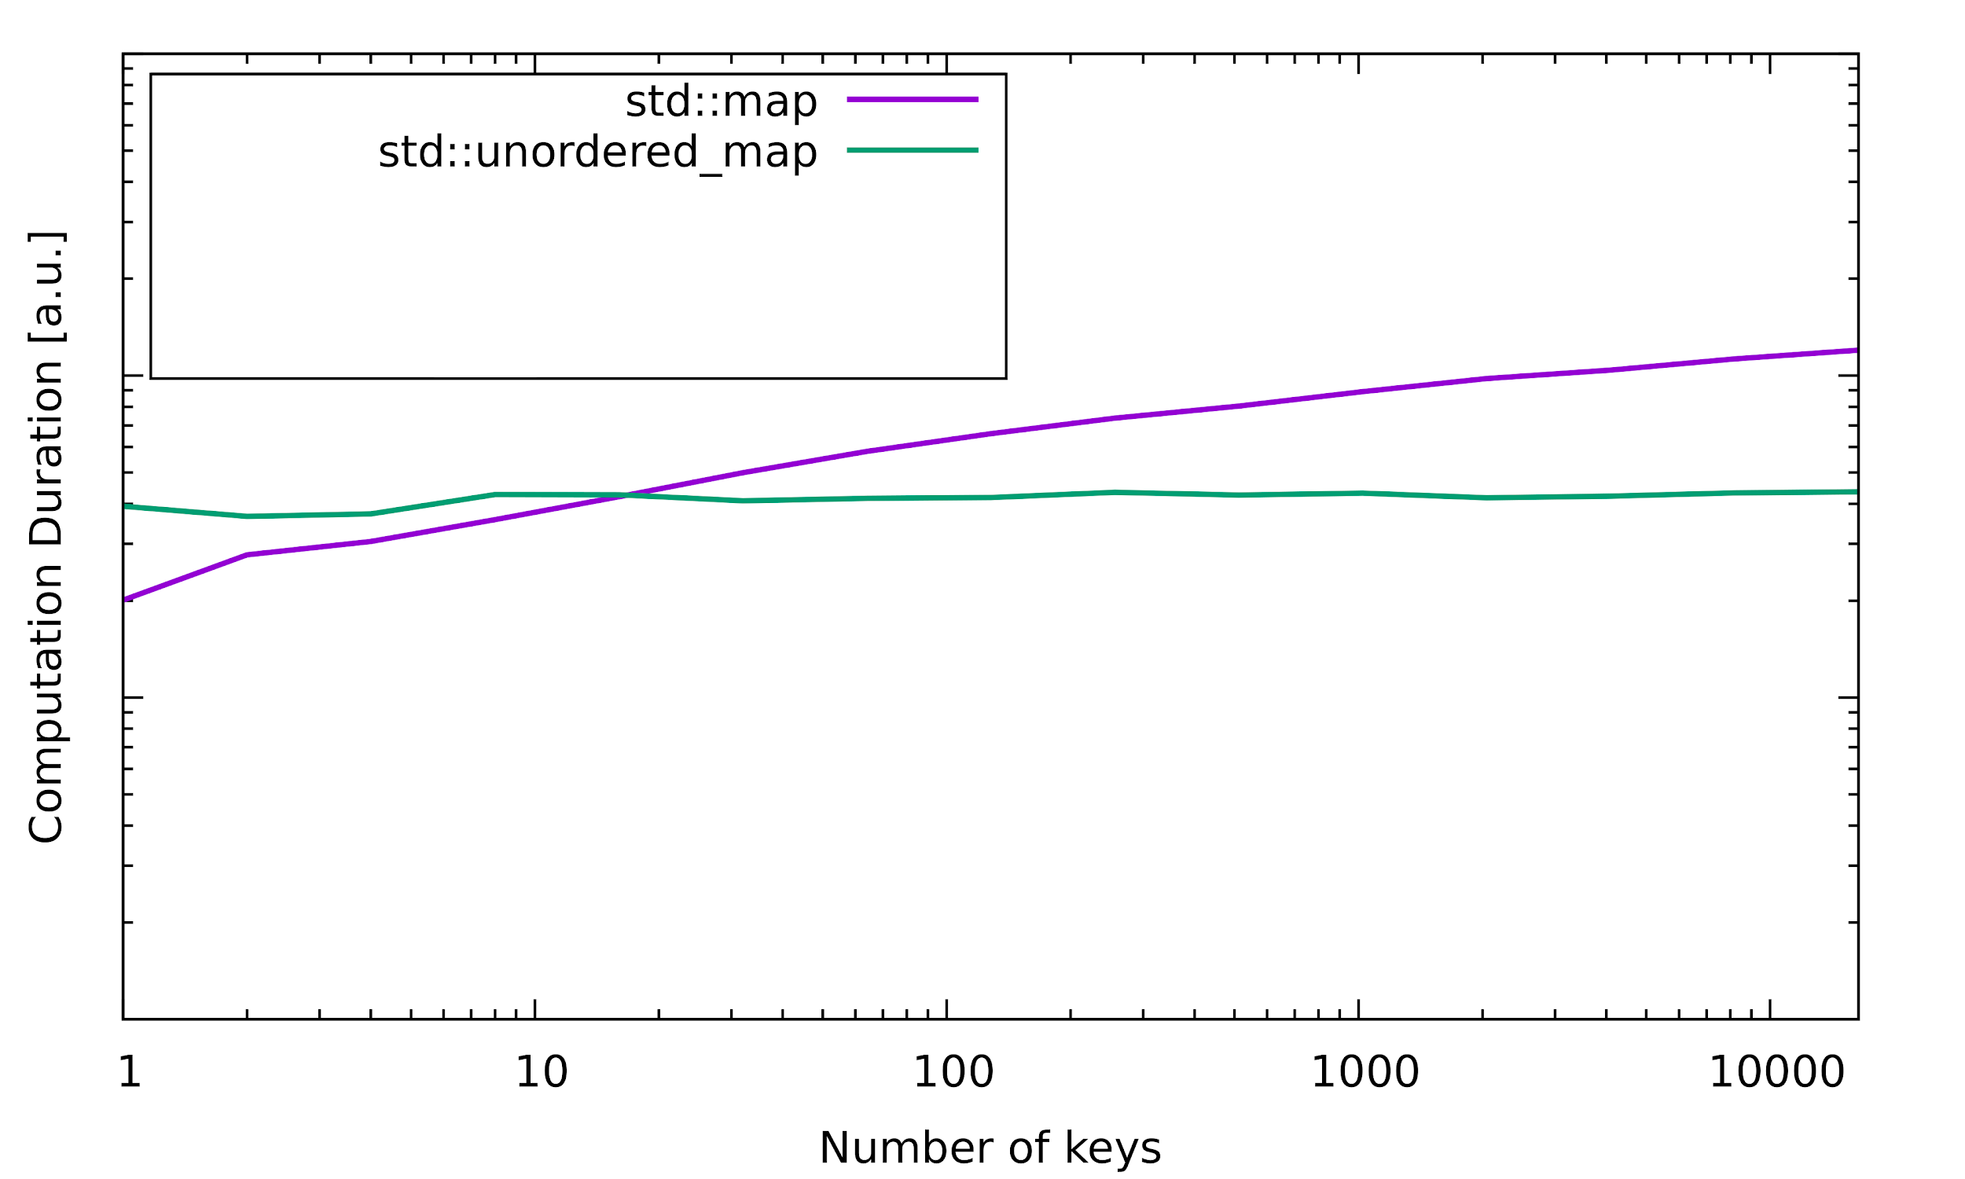
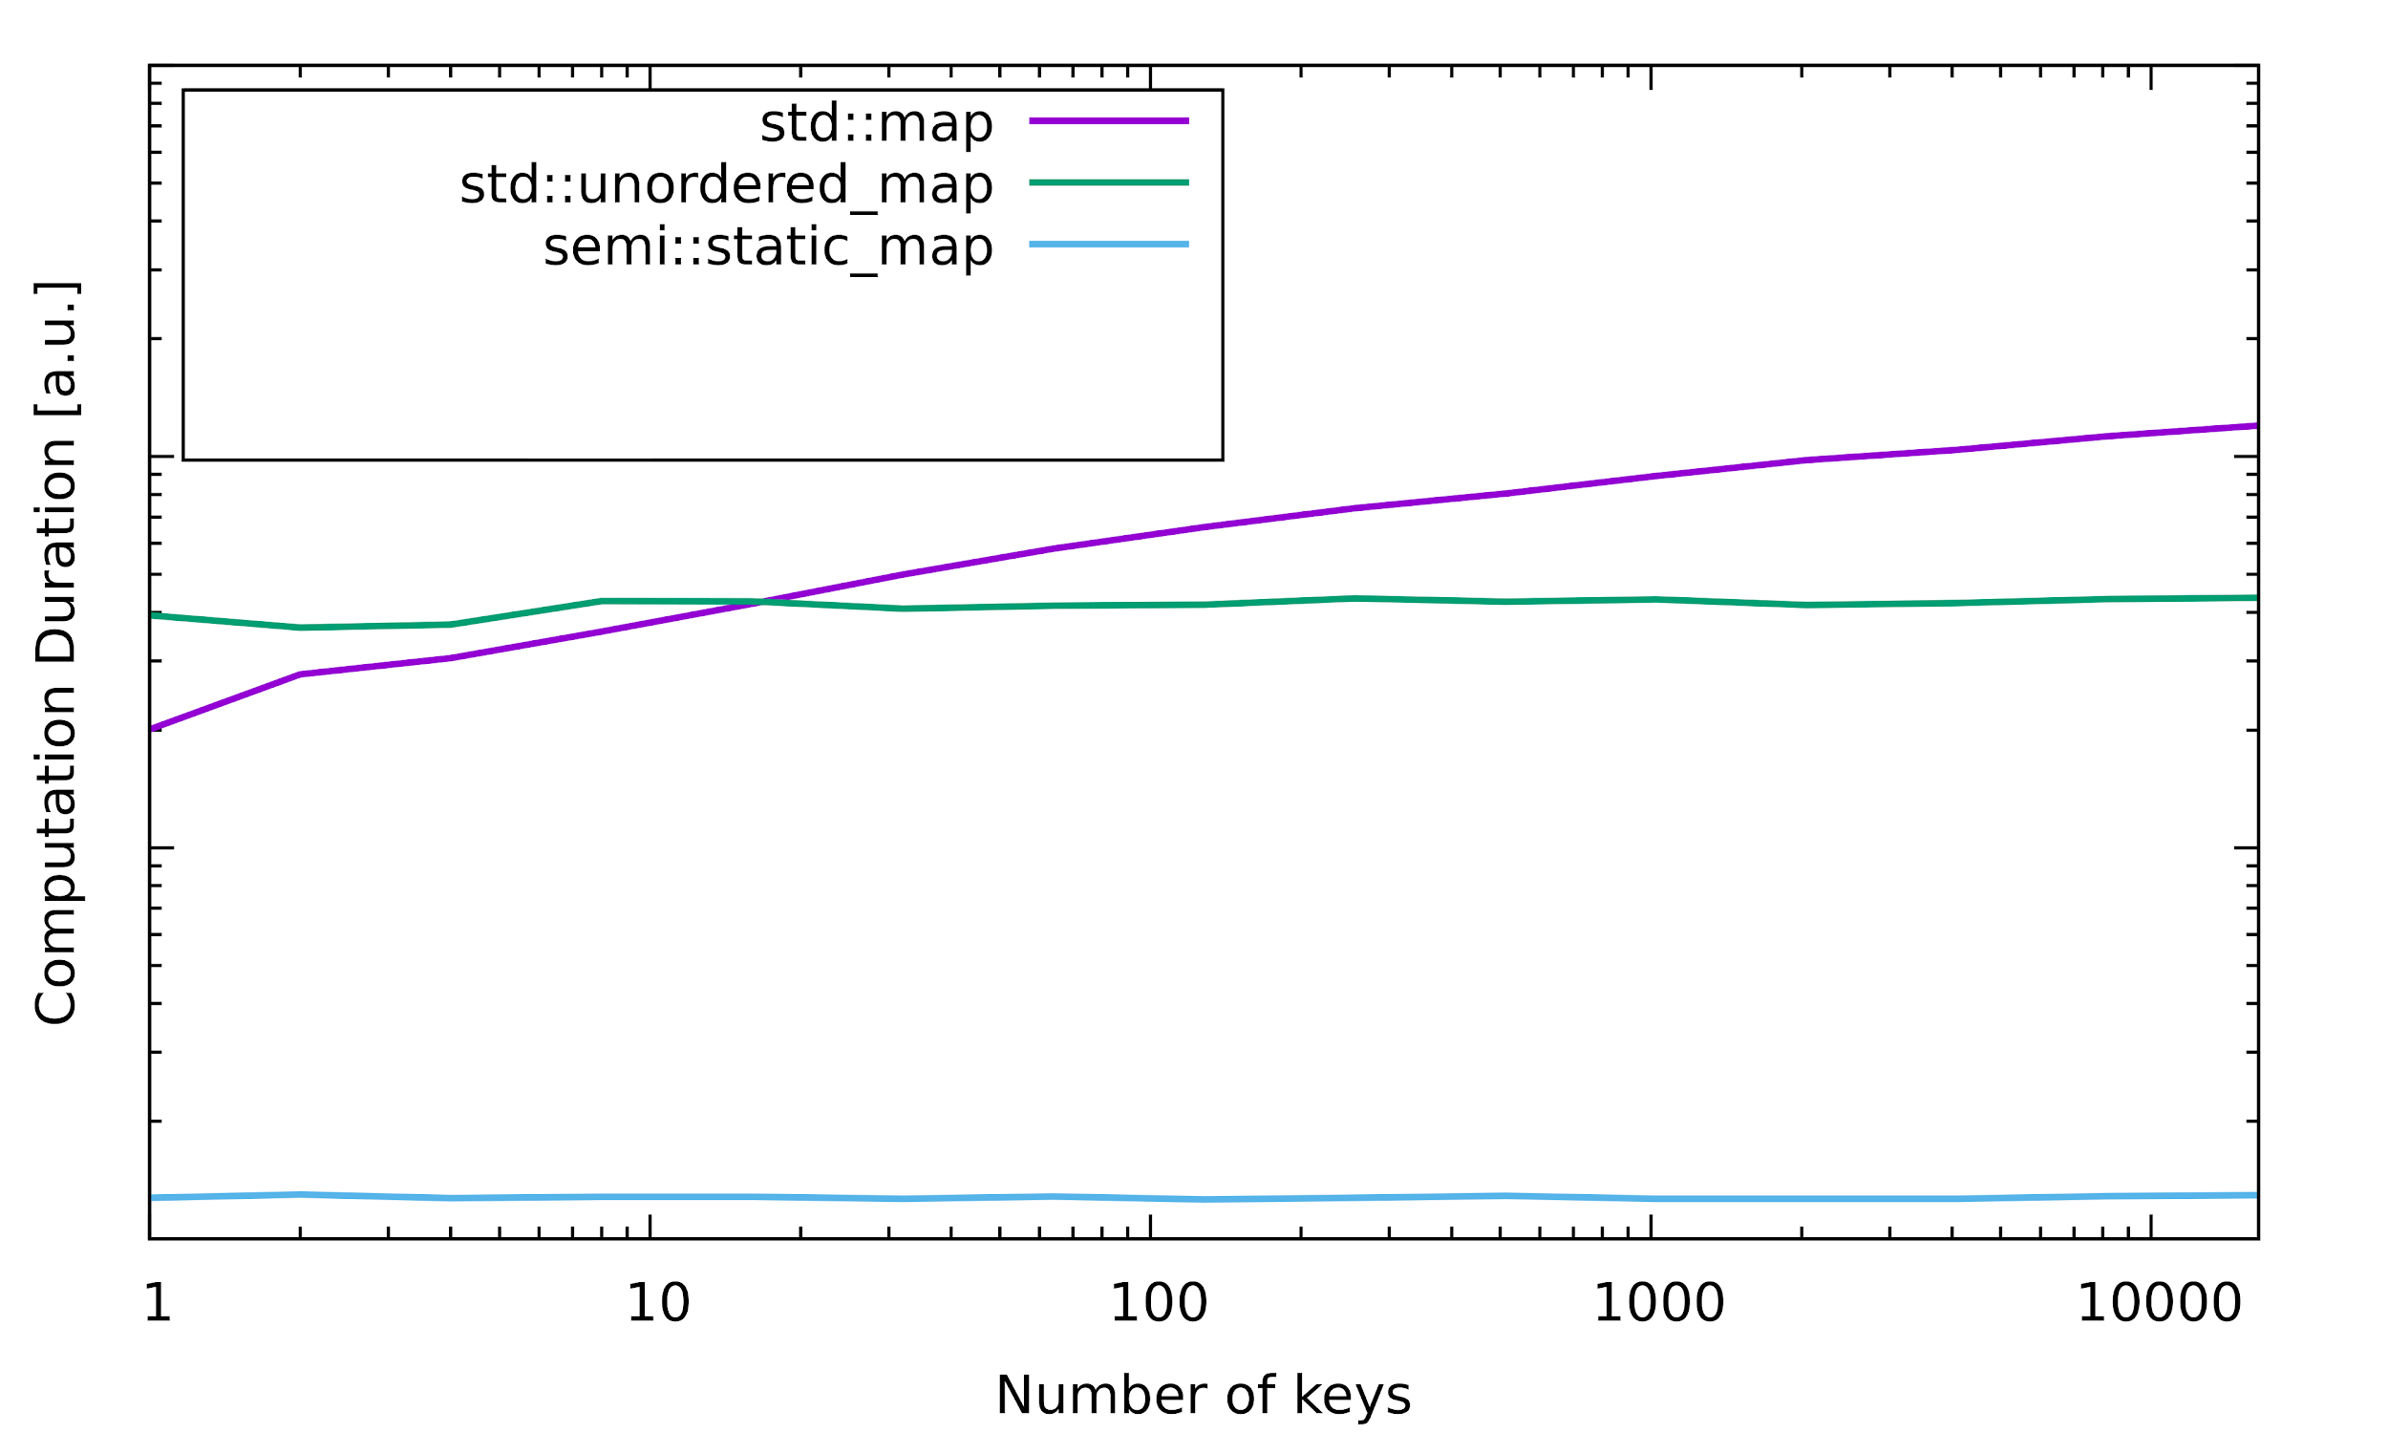
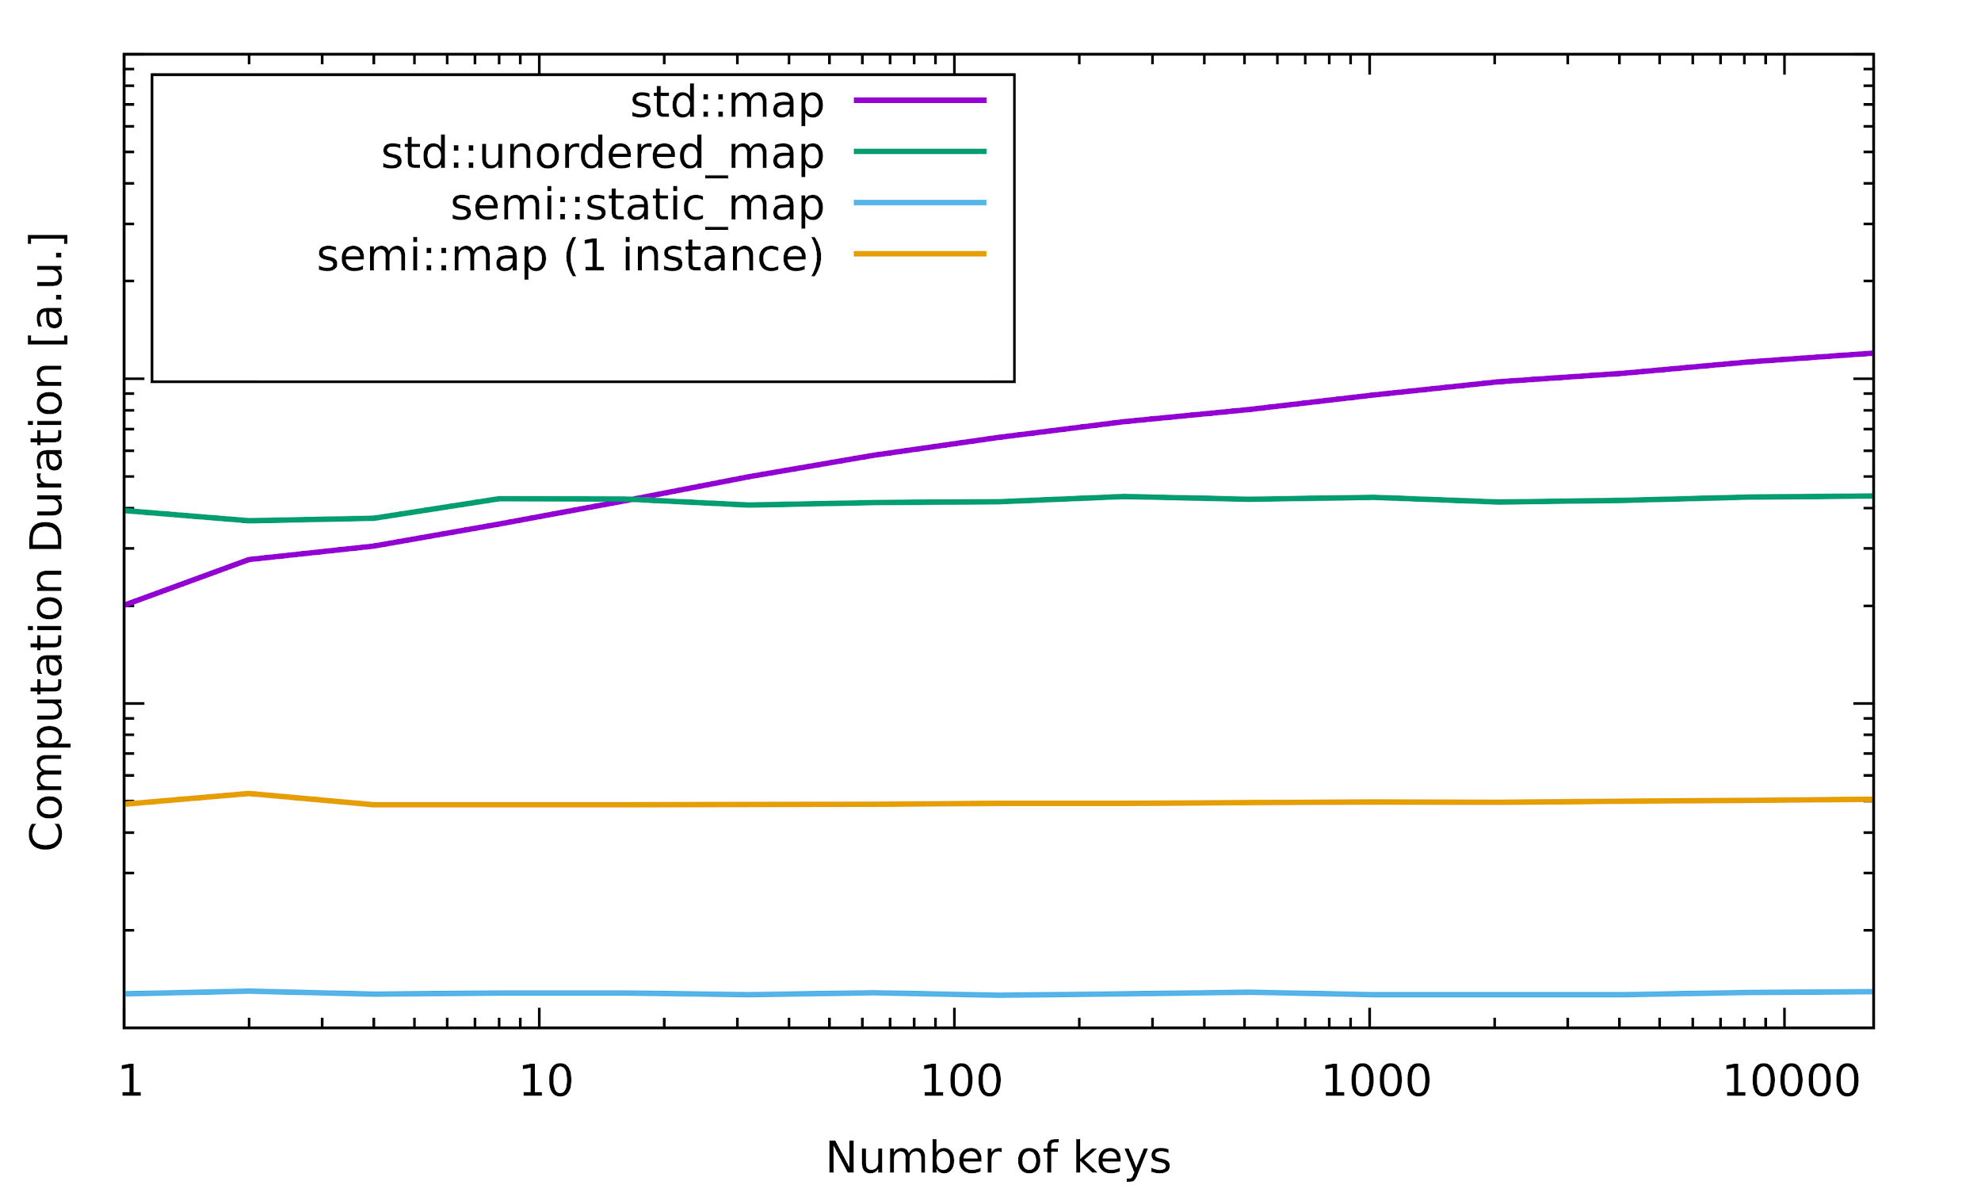
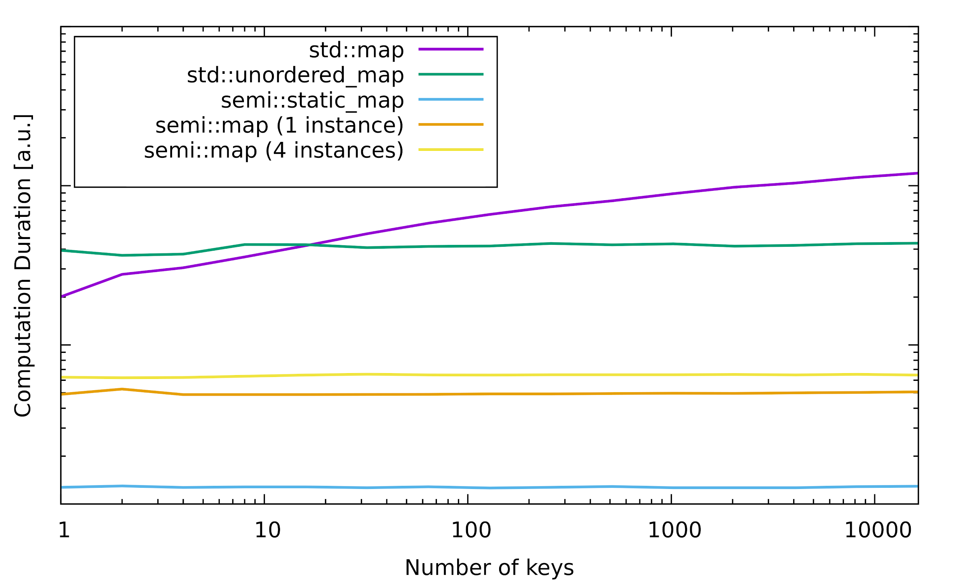
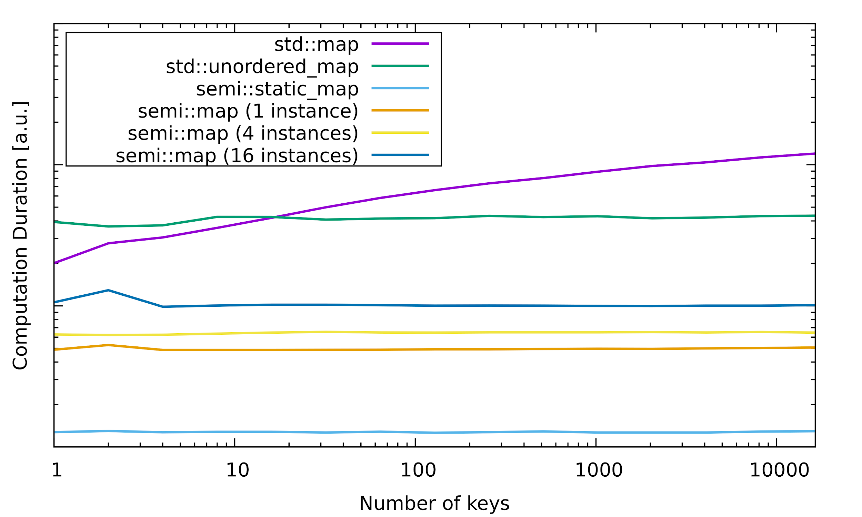
But everything is static?
Benchmarks
Using: clang++ -Ofast -march=native
Notes:
Add that compile-time is very long
Show the big-O of compile-time
Hinted the if(needs_init) with builtin_expect as well

Slide 90
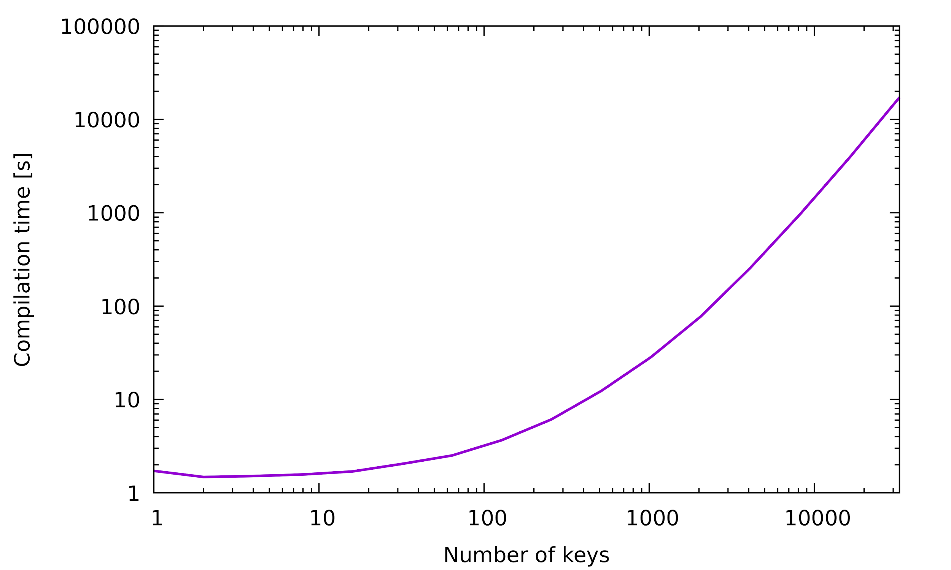
But everything is static?
Benchmarks
Notes:
Add that compile-time is very long
Show the big-O of compile-time
Hinted the if(needs_init) with builtin_expect as well

Slide 91

Thank you!
Code: https://github.com/hogliux/semimap
Video: https://www.youtube.com/watch?v=qNAbGpV1ZkU
@hogliux
fabian.renn@gmail.com
Notes:
Be able to open the code quickly, print-out -

Slide 92
Optional run-time lookup
Only add Value pointer the first time get_internal is called
struct ValueWrapper
{
ValueWrapper (const Key& key) { runtime_map[key] = &v; }
Value v;
};
Faster: Only executed the first time get_internal is called!
template <typename>
static Value& get_internal (const Key& key)
{
static ValueWrapper value(key);
return value.v;
}

Slide 93
Optional run-time lookup
Getting a value from a runtime key is now trivial!
static Value& get(const Key& key)
{
auto it = runtime_map.find(key);
if (it != runtime_map.end())
return it->second;
return runtime_map.emplace_hint(it, key, {new Value, ValueDeleter{nullptr}})->second;
}
Same as before!
Allocate value on heap if not already in runtime_map
We don’t have an init_flat so pass nullptr

Slide 94
Managing key/value life-time
Closer look at the initialise function
void initialise(const Key& key, char* mem, bool& needs_init)
{
auto it = runtime_map.find(key);
if (it == runtime_map.end())
runtime_map.try_emplace(key, new (mem) Value, ValueDeleter{&needs_init});
else
it->second
= std::unique_ptr<Value, ValueDeleter> (new (mem) Value (std::move(it->second)),
ValueDeleter{&needs_init});
}
struct ValueDeleter
{
void operator()(Value* v)
{ if (needs_init != nullptr) { v->~Value(); *needs_init = true;
else { delete v; }
}
bool* needs_init = nullptr;
};

Slide 95
Putting it all together
What’s the performance?
std::string& getName()
{
using map =
semi::static_map<std::string, std::string>;
return map::get(ID("name"));
}
movzx eax, BYTE PTR guard variable
test al, al
je .L15
mov eax, OFFSET FLAT:dummy_tIvalue
ret
.L15:
sub rsp, 8
mov edi, OFFSET FLAT:guard variable
call __cxa_guard_acquire
.
.
.
Only executed the first time value is accessed
Compiler Explorer: https://gcc.godbolt.org/z/Kl8Ynk
Like any static local variable with non-default constructor, the compiler will generate lock guards

